Slide 1
Strings

Slide 2
Strings are Objects
The type is std::string
Defined in the <string> header
Has the usual set of string operations
Underneath, the implementation manages a dynamic, zero-terminated array of characters
C-style

Slide 3
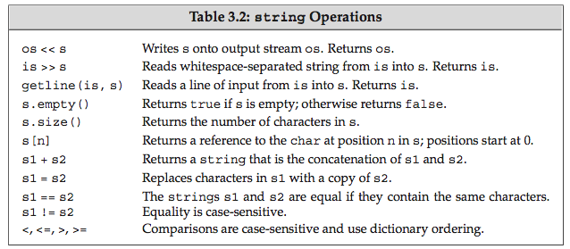
String Operators
Notes:
Emphasize getline.

Slide 4
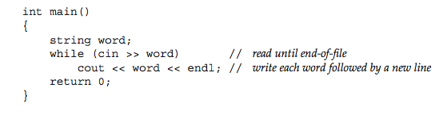
Reading Strings
The >> operator splits on whitespace
Notes:
Do this live.

Slide 5
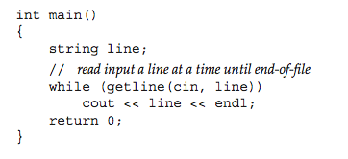
Reading Lines
Use the overload of getline defined in <string>

Slide 6
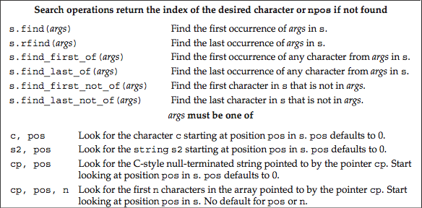
Searching Strings

Slide 7
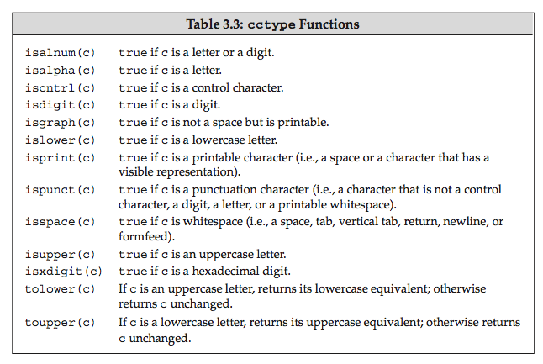
<cctype> Functions

Slide 8
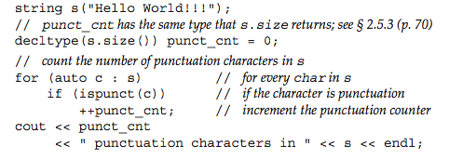
Using <cctype>
Notes:
Counts the number of punct chars. I think s.size() still returns a size_t? All containers have a size() function.

Slide 9
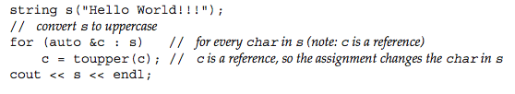
Range-based for and References
Two purposes:
1) doesn’t copy the current value to the loop variable
2) allows changing the sequence element directly (unless const ref)

Slide 10

Subscript Iteration
Notes:
Note the use of decltype. This finesses signed/unsigned problems. I still use size_t out of habit.

Slide 11
String Iterators
int main() {
string s("Now is the time!");
for (auto iter = s.begin(); iter != s.end(); ++iter)
*iter = toupper(*iter);
cout << s << endl;
}

Slide 12
Alternate begin/end Syntax
Accommodates built-in arrays as well as iterators
Works for all containers with iterators
begin(c) maps to c.begin() as needed
int main() {
string s("hello");
for (auto p = begin(s); p != end(s); ++p)
cout << *p; // hello
cout << endl;
int a[] = {1,2,3,4,5};
for (auto p = begin(a); p != end(a); ++p)
cout << *p << ' '; // 1 2 3 4 5
cout << endl;
}

Slide 13

Range-based for Loop
New in C++11

Slide 14
std::to_string (C++11)
#include <iostream>
#include <string> // Defines std::to_string
using namespace std;
int main() {
double x = 7.2;
cout << to_string(x) << endl; // 7.200000
}
Notes:
MinGW doesn’t support this yet.

Slide 15
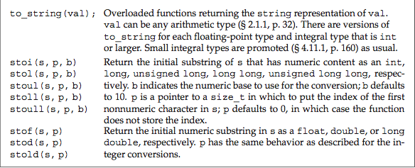
String Conversions
stoi(“7.2”) // 7
stoi(“1011”,0,2) // 11
stoi(“1F”,0,16) // 31
See stox.cpp

